Slide 1
Smart File Extractor
-Data Extraction Tool
M Rohith Reddy
U Raghuram Reddy
Rupesh Subbara

Slide 2
PROJECT OVERVIEW
Goal: Extract structured data from PDFs and images using AI
Core Capabilities:
OCR for scanned docs (Tesseract)
Named Entity Recognition (NER) using BERT
Table extraction (pdfplumber & OCR fallback)
Why It Matters: Automates data retrieval from unstructured documents

Slide 3
TECH STACK
Backend (FastAPI):
Tesseract OCR, pdf2image, pdfplumber
HuggingFace Transformers (BERT), PyTorch
Pillow, NumPy
Frontend (React):
React.js, Axios
JSON Viewer, File Upload
Download functionality

Slide 4





SYSTEM FLOW
Provides a high‑performance REST endpoint and isolates heavy compute from the client.
Enables downstream automation (download, analytics, API chaining) with a machine‑readable result.
Kicks off the entire extraction pipeline with a single, intuitive action.
React Frontend
OCR/NER/
Table Extraction
User
FastAPI
JSON Output
Keeps the UI responsive and handles large files without page reloads.
Modular pipeline ensures the best tool is used for each content type, delivering higher accuracy.

Slide 5
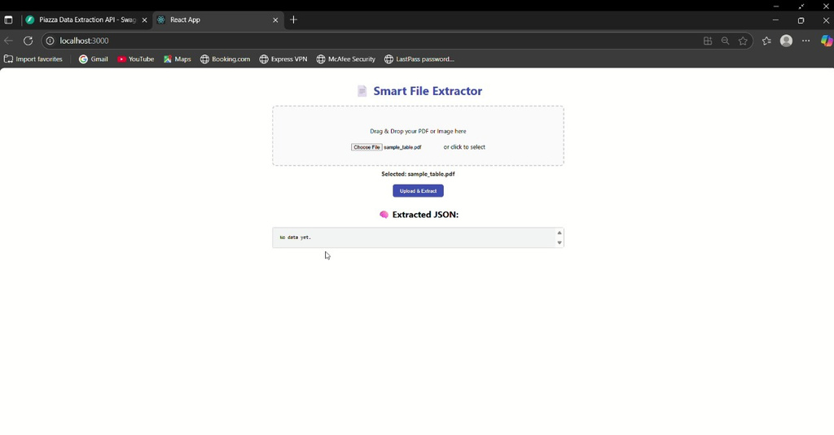
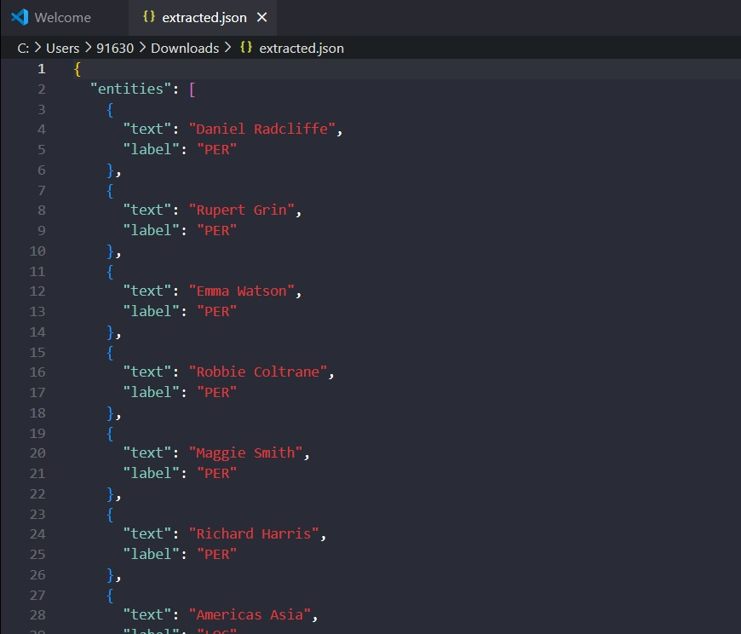
EXPECTED RESULTS
Extracted data as JSON and downloaded the file.

Slide 6
CONCLUSION & ROADMAP
Impact: Fast, reliable extraction of key data
Use Cases: Legal docs, resumes, academic papers, reports
Scope for Improvements:
Export to CSV/Excel
Multi-language OCR
File history & login system

Slide 7
Thank you!

